Slide 1
Fetch Rewards Data Analysis and findings
Amal Sharma

Slide 2
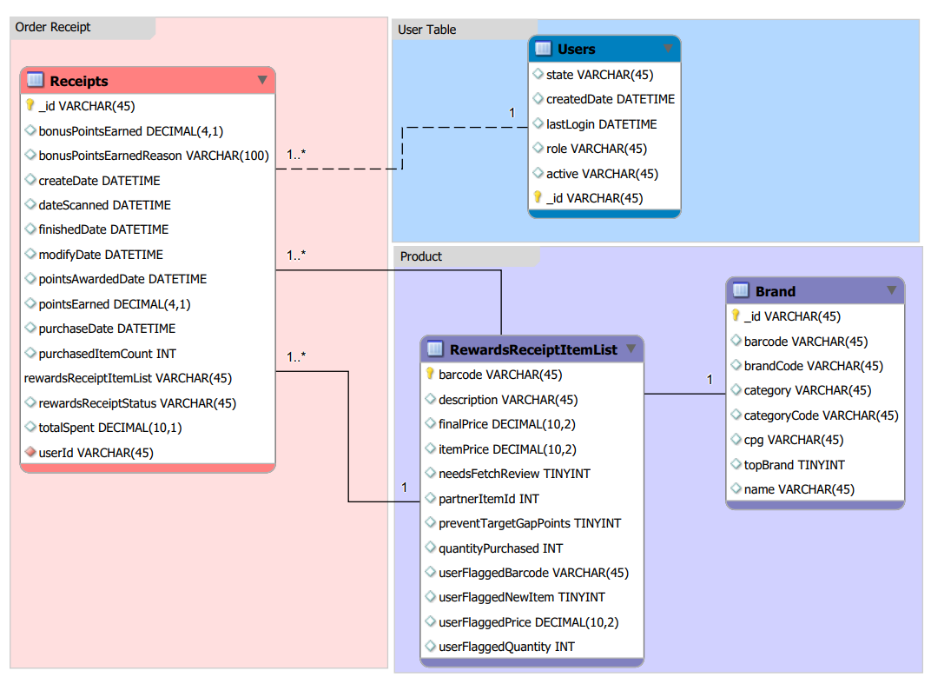
Proposed Database

Slide 3
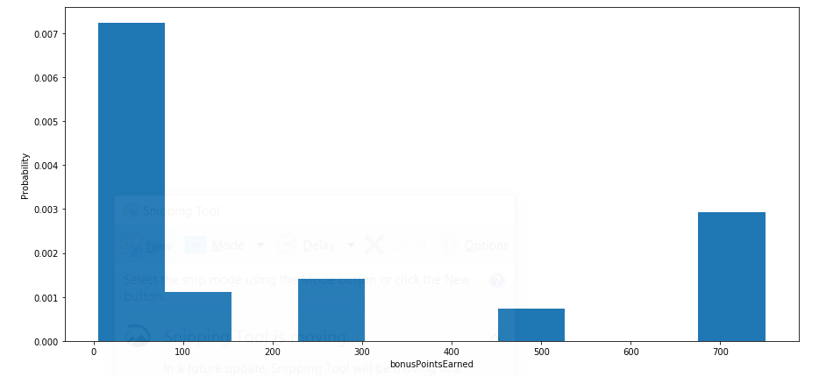
Data Exploration
Bonus Point Earned Distribution

Slide 4
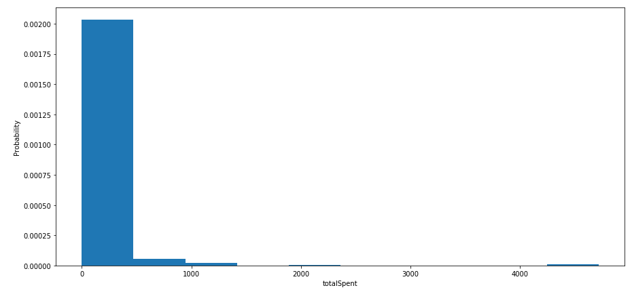
Data Exploration
Total Spent Distribution

Slide 5
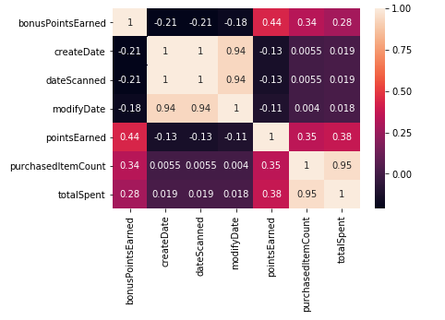
Data Exploration
Correlation Matrix

Slide 6
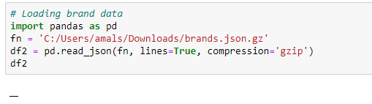
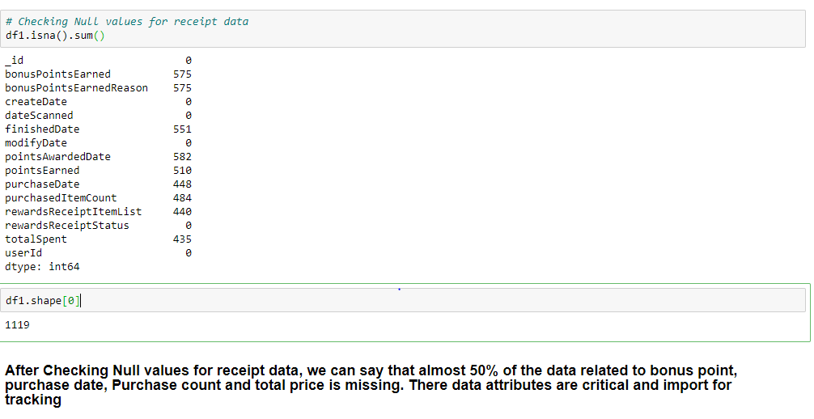
Data Quality Issue
Missing Values

Slide 7
Data Quality Issues
Category | Data Quality Issue | Resolution
Data Value Missing | Almost 50% of data related to bonus point, purchase date, Purchase count and total price of the receipt is missing which hinders to find the correlation between receipt amount and rewards earned. | Not Null Constraints to be put in the Schema to avoid missing value
Date not present | There is no data related to brand in the brand table so we cannot analyze our top brands and their Year of year performance. | Put Foreign key, Not null constraint so that data can be maintenance can be made mandatory
Format Standard | Date Format is not as per the standard. So not able to find out the past trends and predict the future growth | Define the Date format standard as per standard Db practice or Develop function which will get the system date & time while entering the record in the table.

Slide 8
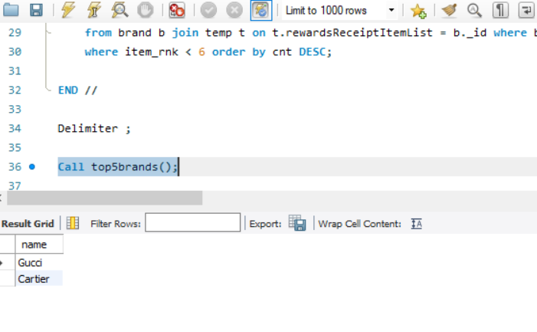
SQL Reports
SQL Reports
Top Brands

Slide 9
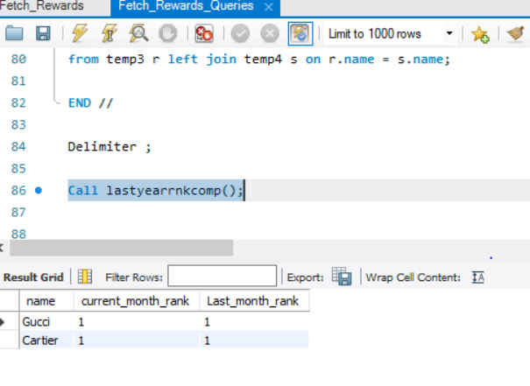
SQL Reports
SQL Reports
Last month top brand comparison

